Slide 1

Binary Search Trees: Basic Operations
Saif Hassan
Department of Computer Science
Sukkur IBA University
Data Structures
Data Structures and Algorithms

Slide 2
Agenda
Basic operations (Find, Next Element, Insert and Delete)
Implementations
Examples

Slide 3
Learning Objectives
Implement basic operations on Binary Search Trees.
Understand some of the difficulties with making updates.

Slide 4
Find
Find
Input:Key k, Root R
Output:The node in the tree of R with key k

Slide 5
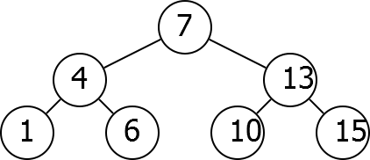
Idea
Find(6)

Slide 6
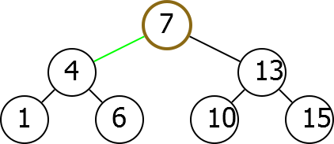
Idea
Find(6)

Slide 7
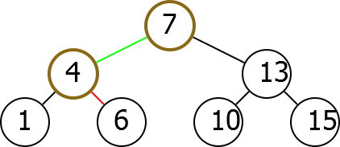
Idea
Find(6)

Slide 8
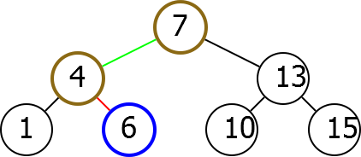
Idea
Find(6)

Slide 9
Algorithm
Find(k, R)
if R.Key = k: return R
else if R.Key > k :
return Find(k, R.Left) else if R.Key < k :
return Find(k, R.Right)

Slide 10
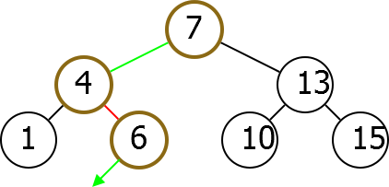
Missing Key
Run Find(5).
Key not in tree. Did find point where it should be.

Slide 11
Missing Key
If you stop before reaching a null pointer, you find the place in the tree where k would fit.

Slide 12
Modification
Find (modified)
else if R.Key > k :
if R.Left ̸= null:
return Find(k, R.Left) return R

Slide 13
Adjacent Elements
Given a node N in a Binary Search Tree, would like to find adjacent elements.

Slide 14
Next
Next
Input: Node N
Output: The node in the tree with the next largest key.

Slide 15
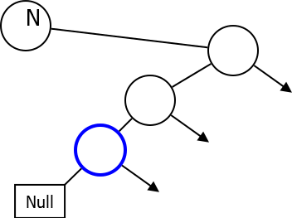
Case I
If you have right child.

Slide 16
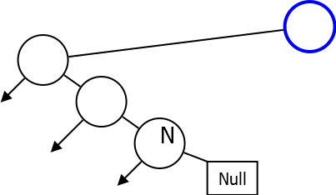
Case II
No right child.

Slide 17
Next
Next(N )
if N.Right ̸= null:
return LeftDescendant(N.Right) else:
return RightAncestor(N )

Slide 18
Left Descendant
LeftDescendant(N )
if N.Left = null
return N
else:
return LeftDescendant(N.Left)

Slide 19
Right Ancestor
RightAncestor(N )
if N.Key < N.Parent.Key return N.Parent
else:
return RightAncestor(N.Parent)

Slide 20
Range Search
Range Search
Input: Numbers x, y , root R
Output: A list of nodes with key between x and y

Slide 21
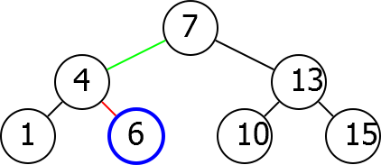
Idea
RangeSearch(5, 12).

Slide 22
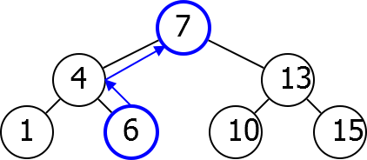
Idea
RangeSearch(5, 12).

Slide 23
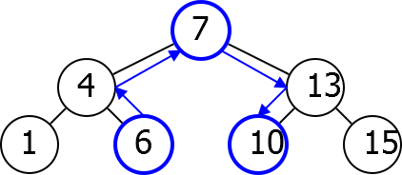
Idea
RangeSearch(5, 12).

Slide 24
Implementation
RangeSearch(x , y, R)
L ← ∅
N ← Find(x , R)
while N.Key ≤ y
if N.Key ≥ x :
L ← L.Append(N )
N ← Next(N)
return L

Slide 25
Insert
Insert
Input:Key k and root R
Output:Adds node with key
k to the tree

Slide 26

Insert Idea
Insert(3)

Slide 27
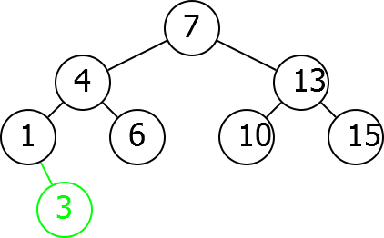
Insert Idea
Insert(3)

Slide 28
Implementation
Insert(k, R)
P ← Find(k, R)
Add new node with key k as child of
P

Slide 29
Delete
Delete
Input:Node N
Output:Removes node
N from the tree

Slide 30
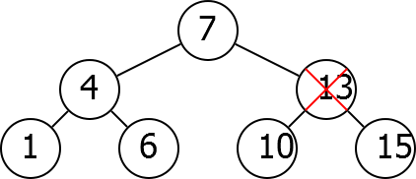
Difficulty
Cannot simply remove.
Delete(13)
Notes:
Now there's a problem we can't just delete the node because then its
parent doesn't have a child.
It's children don't have parents, it breaks things apart.
So we need to find some way to fill the gap.

Slide 31
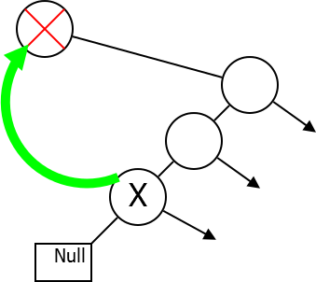
Idea
Notes:
And there is a natural way to fill this gap.
The point is you want to fill the gap with something nearby in the sorted order, so
you try and find the next element, X, and maybe you just take X and
fill the gap that you created by deleting this.

Slide 32
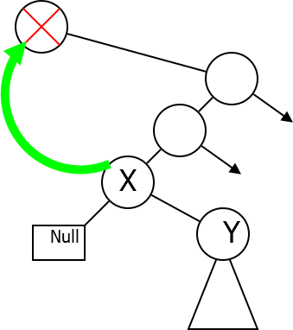
Idea
Notes:
Unfortunately, there could be a problem.
Now, X is the next element that have not
a left child.
But it might have a right child and if it does have this right child,
then by moving X side of the way it's right child is now going to be disconnected from tree.
It's not going to have a proper parents.

Slide 33
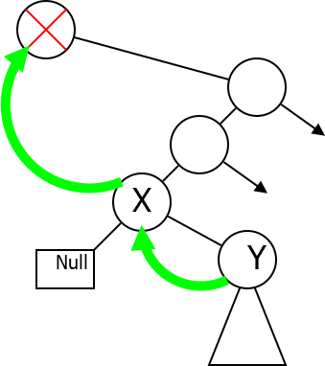
Idea
Notes:
So in addition to moving X to fill that gap you have to move Y
up to fill the gap that you made by moving X out of the way.

Slide 34
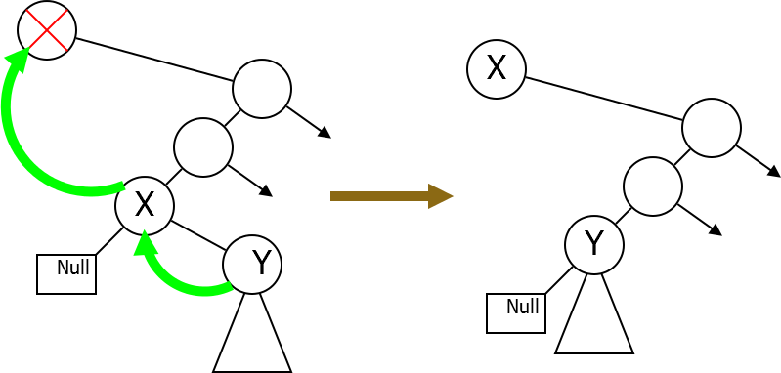
Idea
Notes:
But once you do that it's actually perfectly good.
You've done a reasonable rearrangement tree and removed nodes you want.
So the implementation takes a little bit of work.

Slide 35
Implementation
Delete(N )
if N.Right = null:
Remove N , promote N.Left else:
X ← Next(N )
\\ X.Left = null
Replace N by X , promote X.Right
Notes:
First you check to see if N has a right child.
If it's right child is null then you will just remove N and youneed to promote Ns left child, if it has one.
So Ns left child should now become the child of Ns parent
instead of the other way around.
But in case right child of N is not null, then we're going to let X be next of N and
note that X does not have a left child.
And then we're going to replace N by X and promote Xs right child to
fill the gap that we made by moving X out of the way.

Slide 36
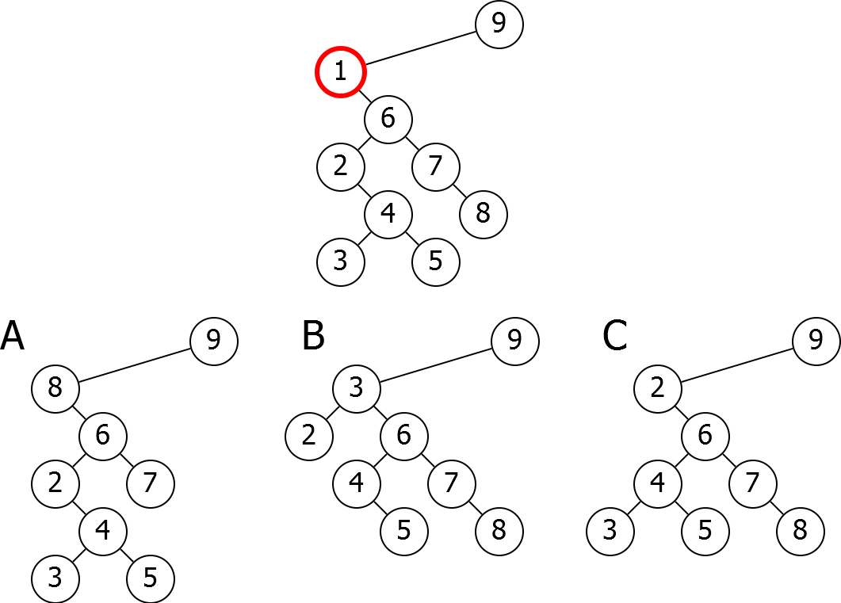
Problem
Which of the following trees is obtained when the selected node is deleted?

Slide 37
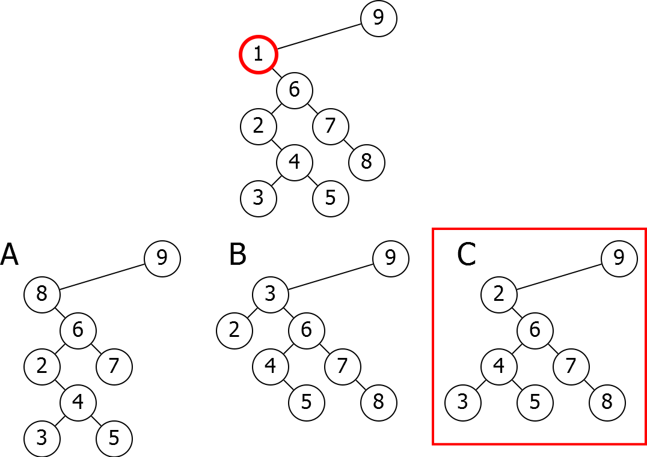
Problem
Which of the following trees is obtained when the selected node is deleted?
Notes:
The point is that we deleted 1 so
we want to replace it with the next element which is 2.
So we took 2 and put it to the place where 1 was.
Now 2s child, 4, needs to be promoted.
So 4 now becomes the new child.
Six and everything works nicely and in this tree.

Slide 38
Next Time
Runtime and balance.

